Slide 1
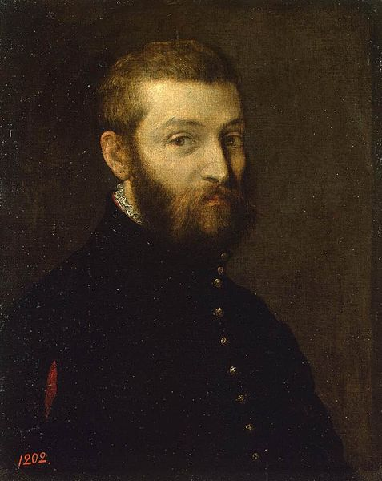

Paolo Veronese
1528-1588
Italian Renaissance Painter
New Testament

Slide 2
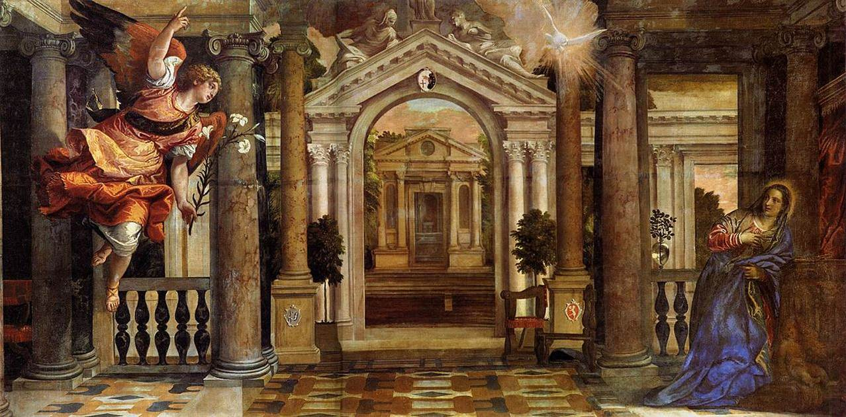
The Annunciation

Slide 3
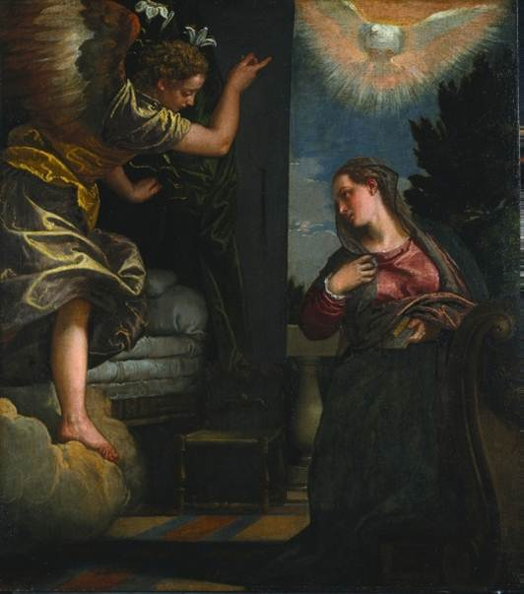
The Annunciation

Slide 4
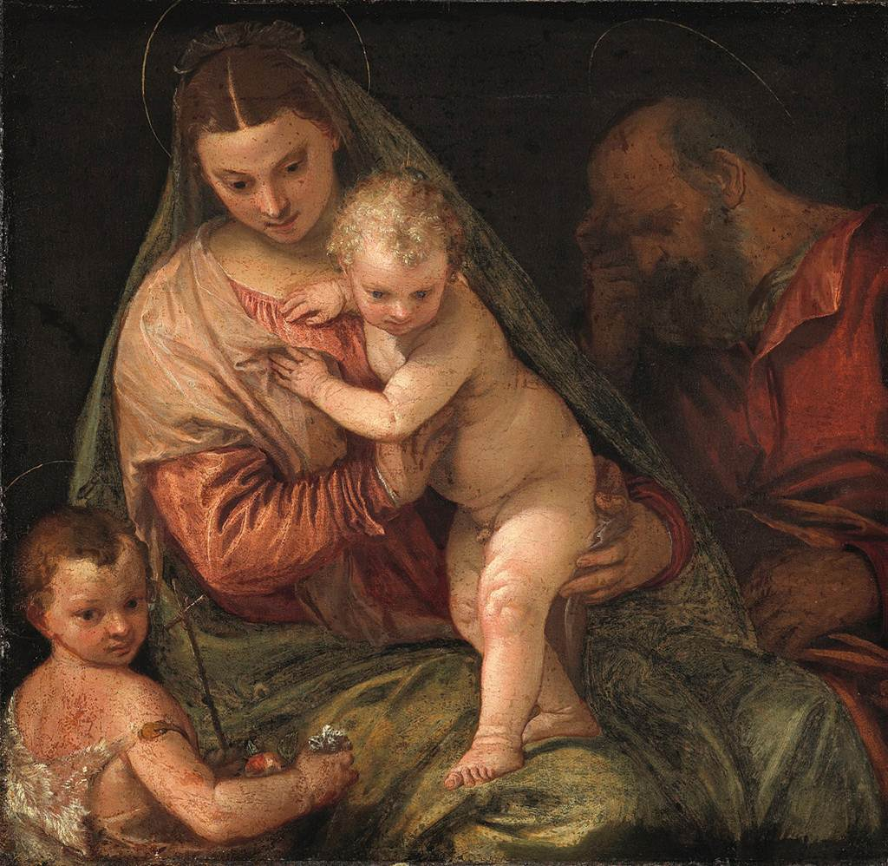
The Holy Family with the Infant
St. John
the Baptist

Slide 5
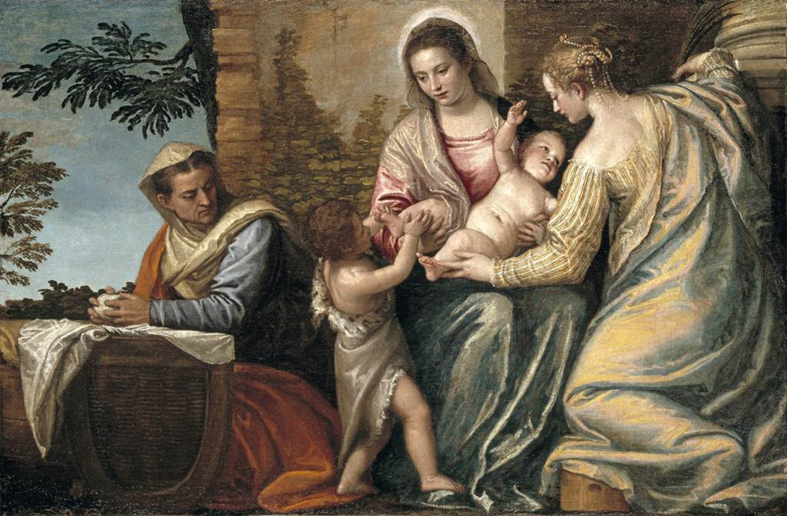
Madonna and Child with St. Elizabeth,
the Infant St. John the Baptist, and St. Justina

Slide 6
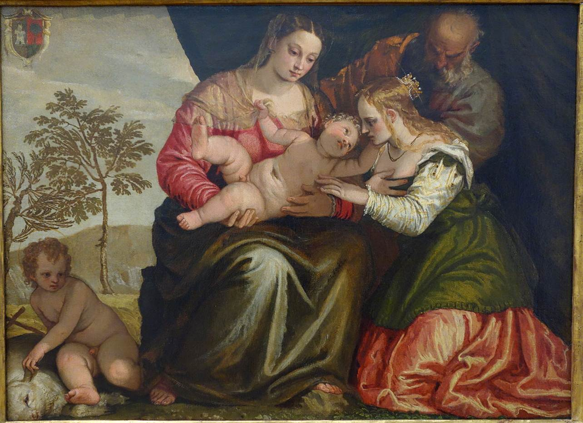
Mystical Marriage of Saint Catherine

Slide 7
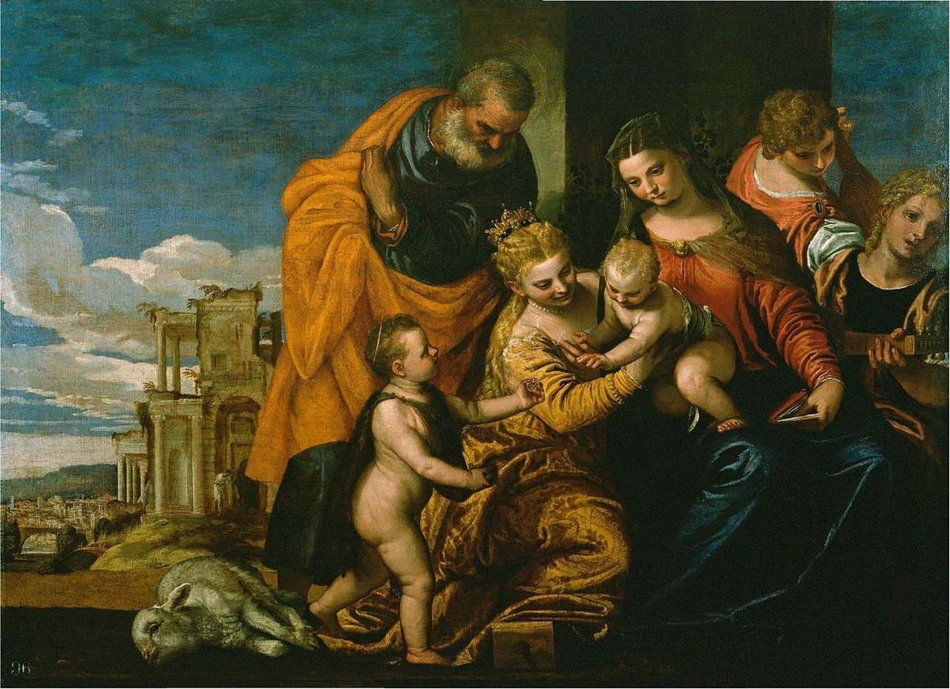
Mystical Marriage of Saint Catherine

Slide 8
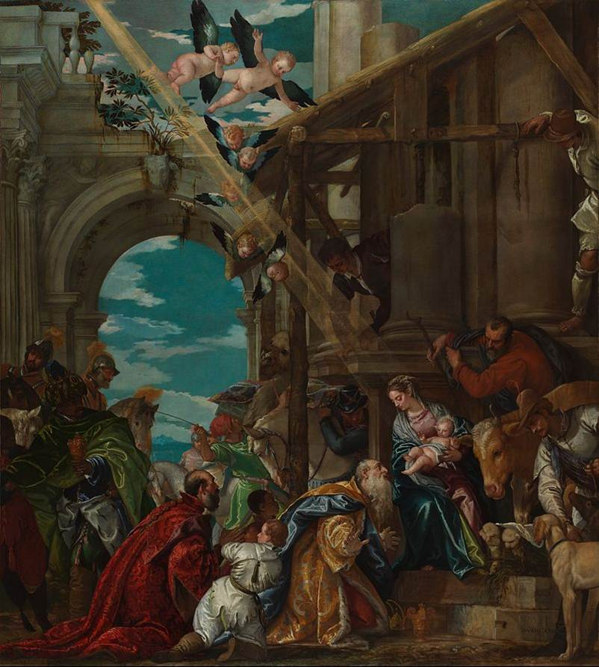
Adoration of the Magi

Slide 9
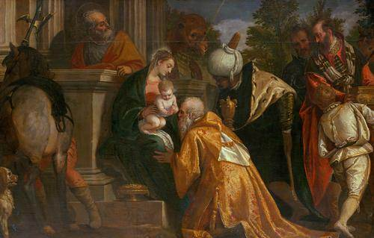
Adoration of the Magi

Slide 10
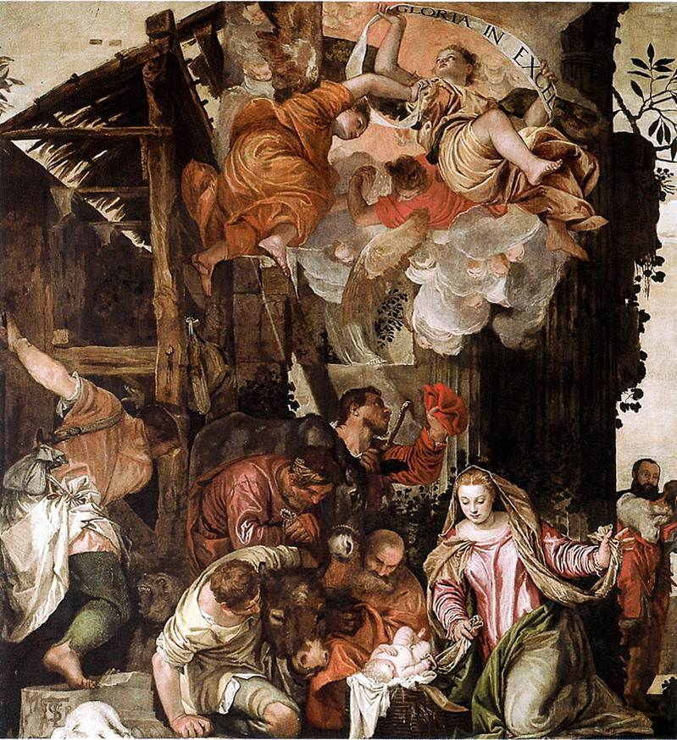
Adoration of the Shepherds

Slide 11
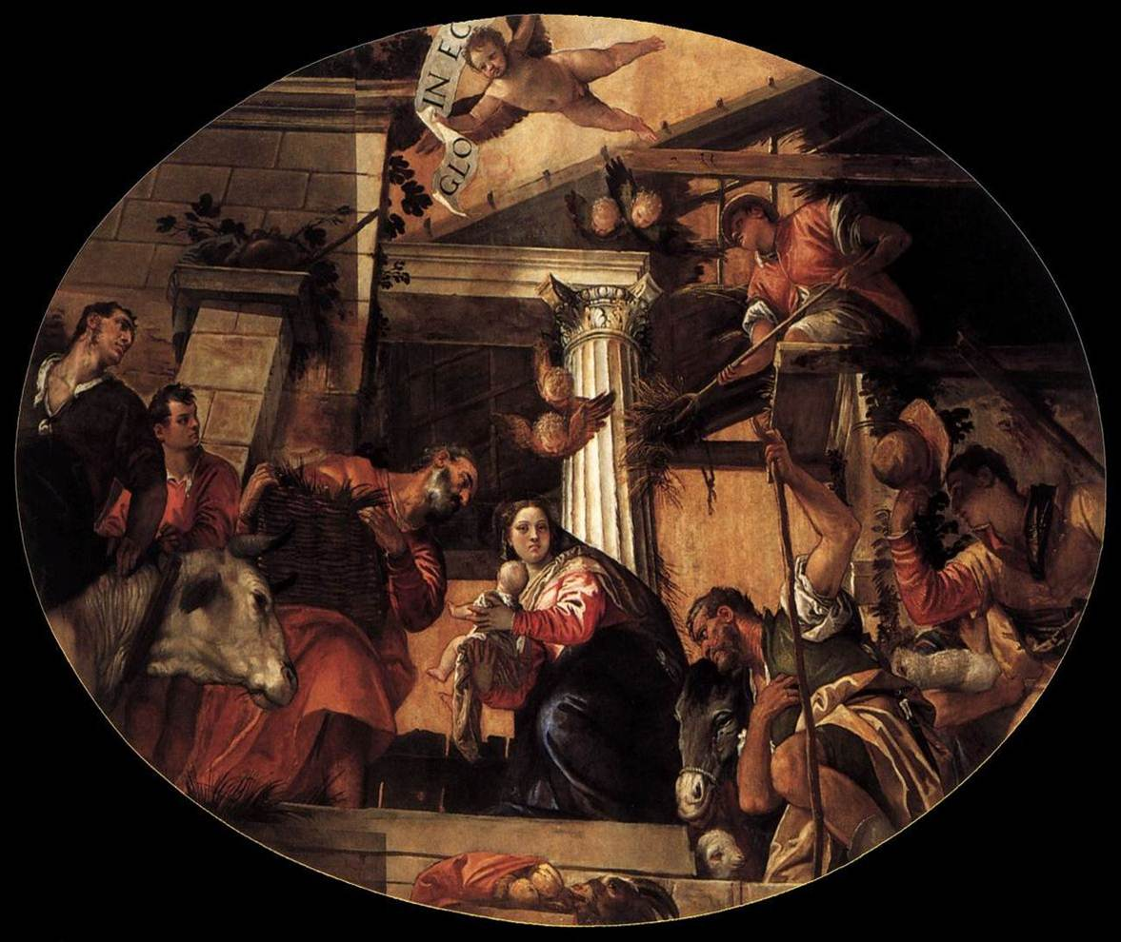
Adoration of the Shepherds

Slide 12
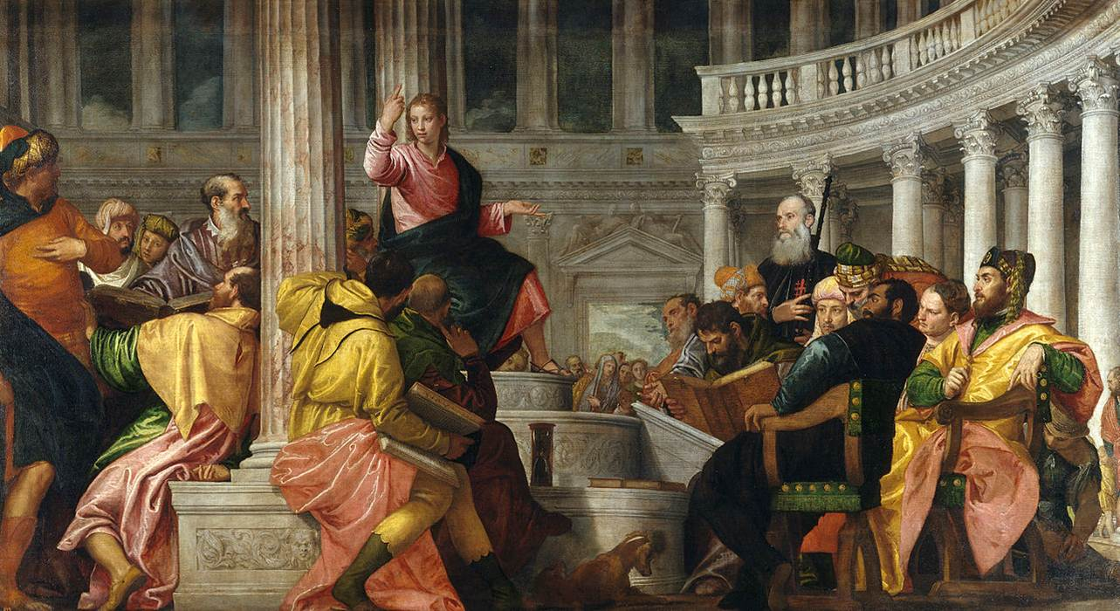
Jesus among the Doctors

Slide 13
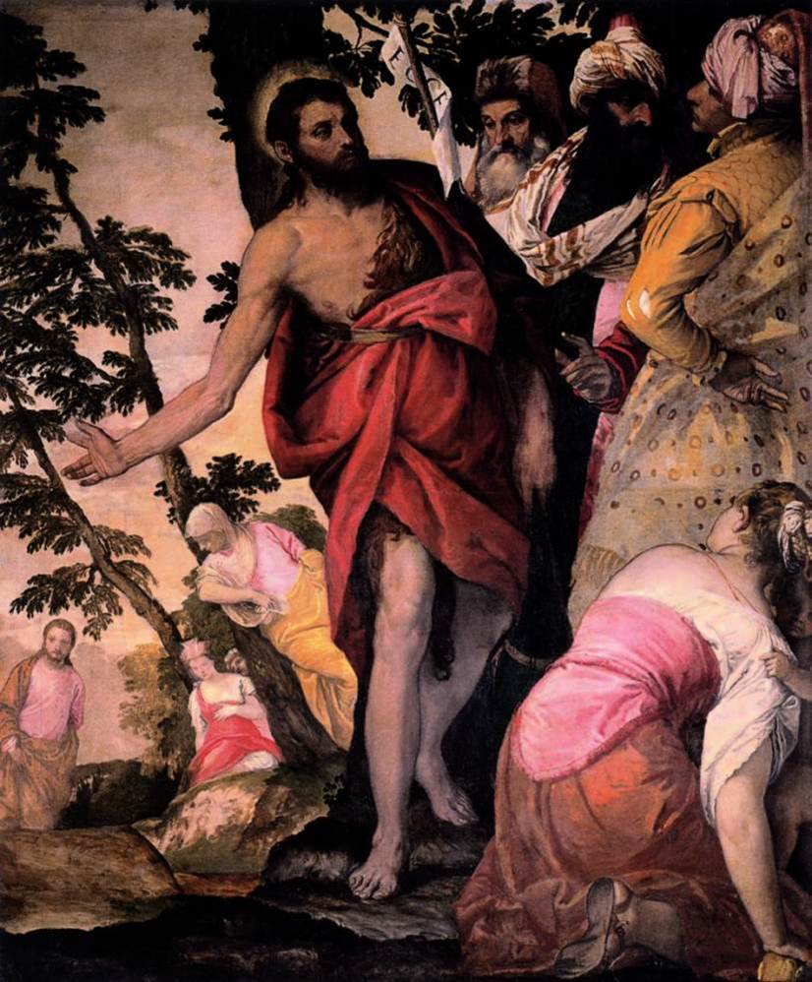
St. John the Baptist
Preaching

Slide 14
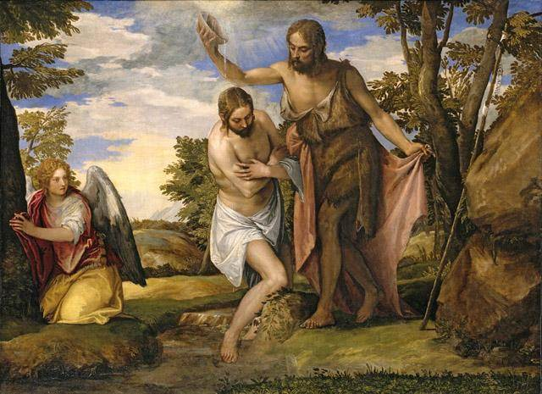
The Baptism of Christ(막 1:9)

Slide 15
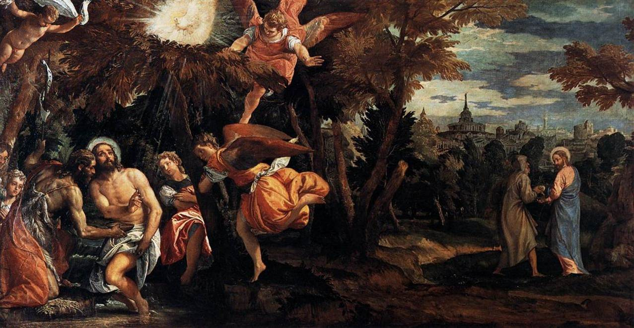
Baptism and Temptation of Christ

Slide 16
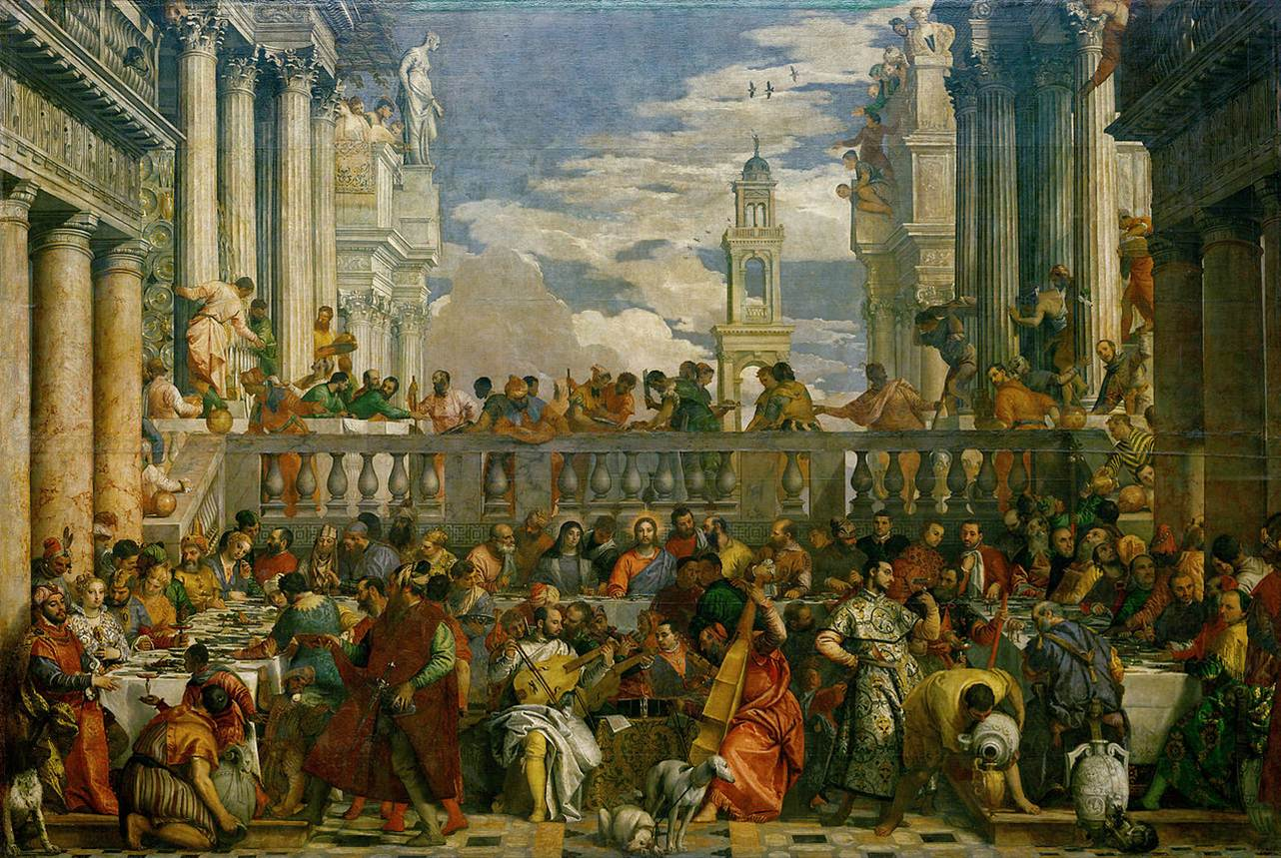
The Marriage at Cana 1563(요 2:8)

Slide 17
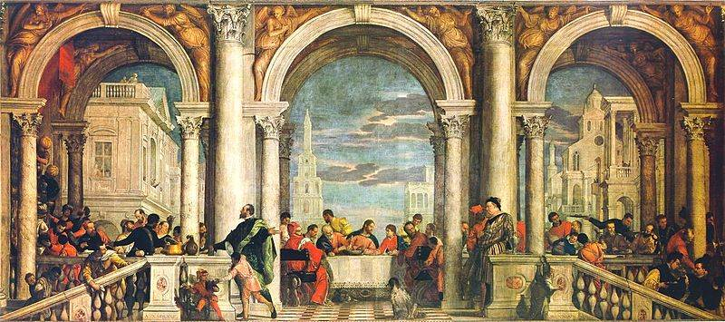
The Feast in the House of Levi(Matthew) (막2:15)

Slide 18
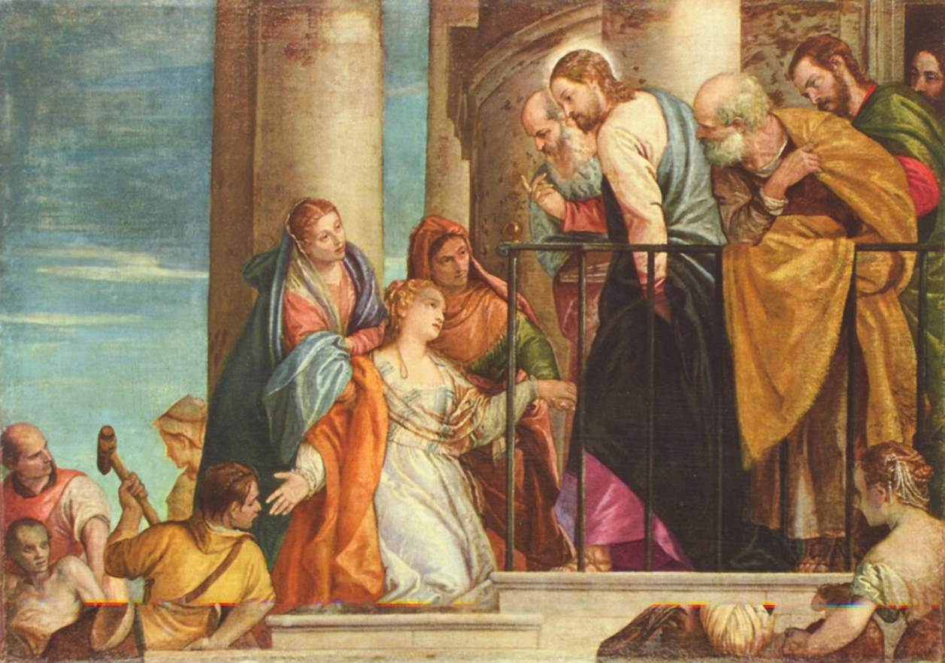
The Raising of the Youth of Nain(눅 7:14)

Slide 19
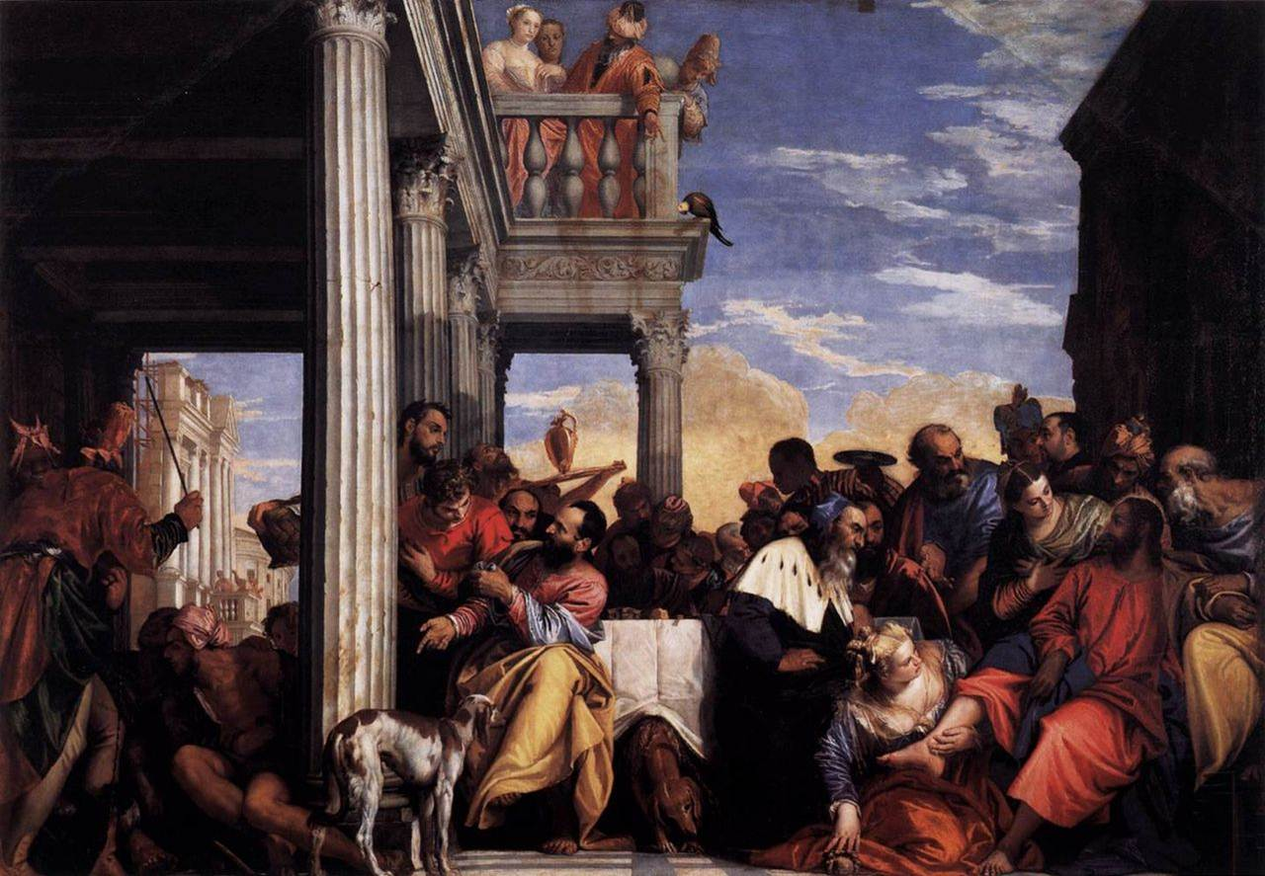
Feast at the House of Simon(막 14:3)

Slide 20
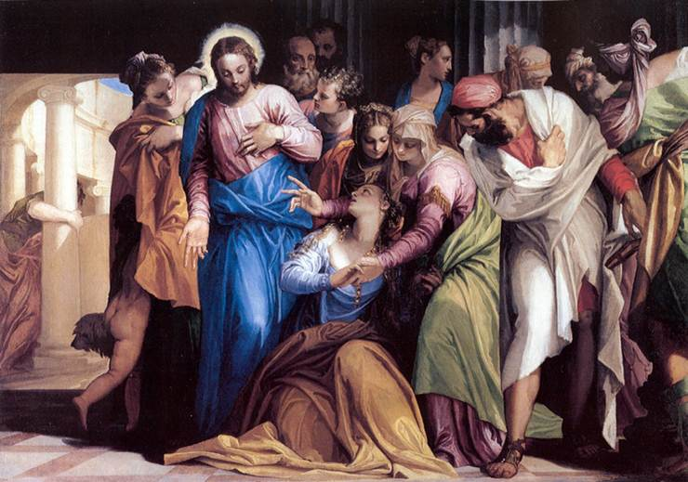
Conversion of Mary Magdalene(눅 8:2)

Slide 21
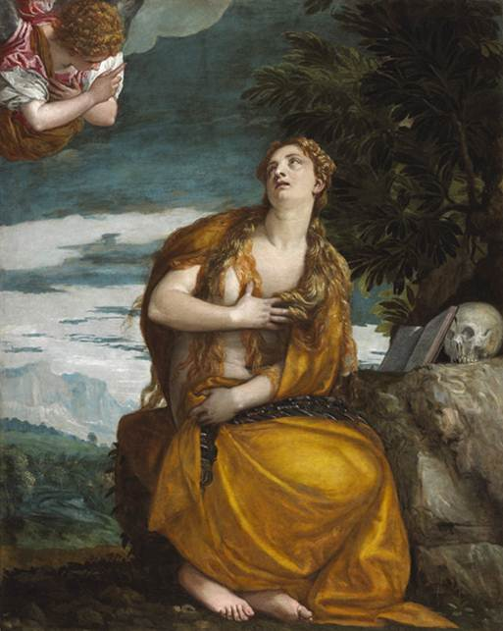
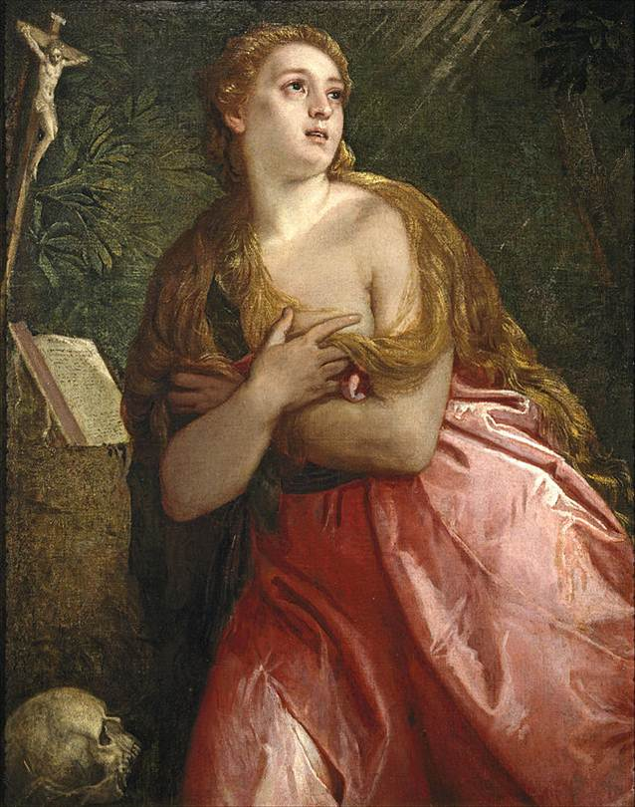
The penitent Mary Magdalene

Slide 22
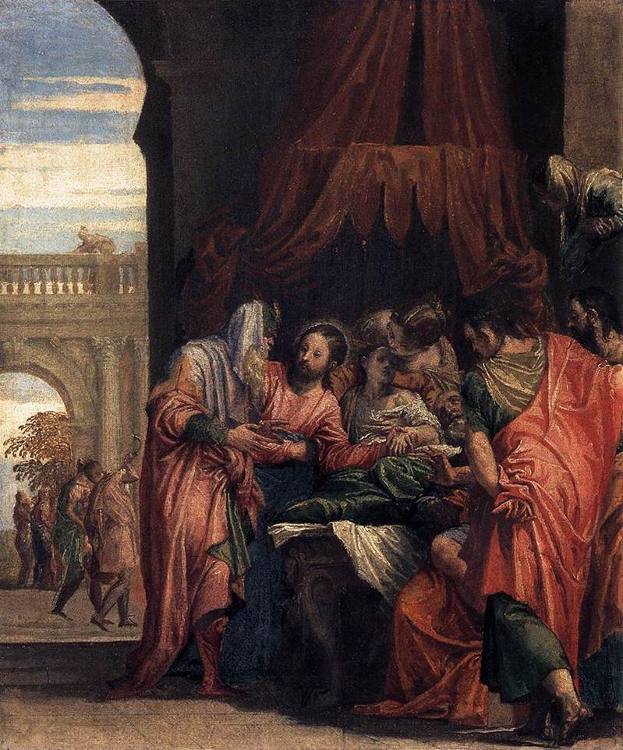
Raising of the Daughter of Jairus

Slide 23
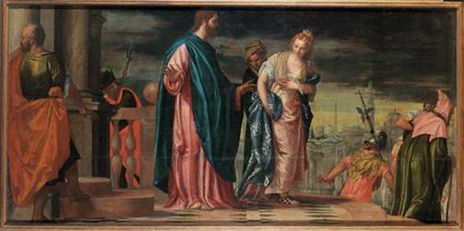
Christ and the Adulteress(요 8:3)

Slide 24
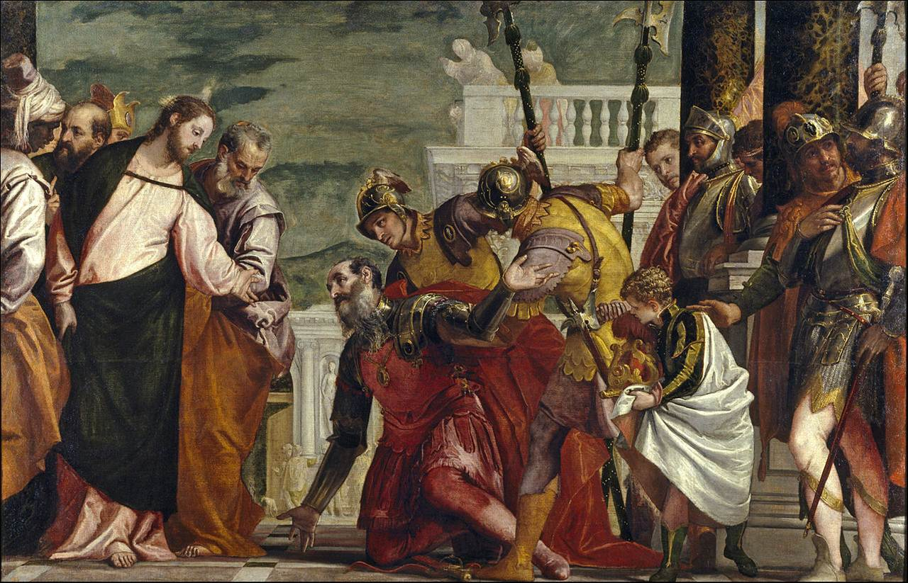
Jesus and the Centurion

Slide 25
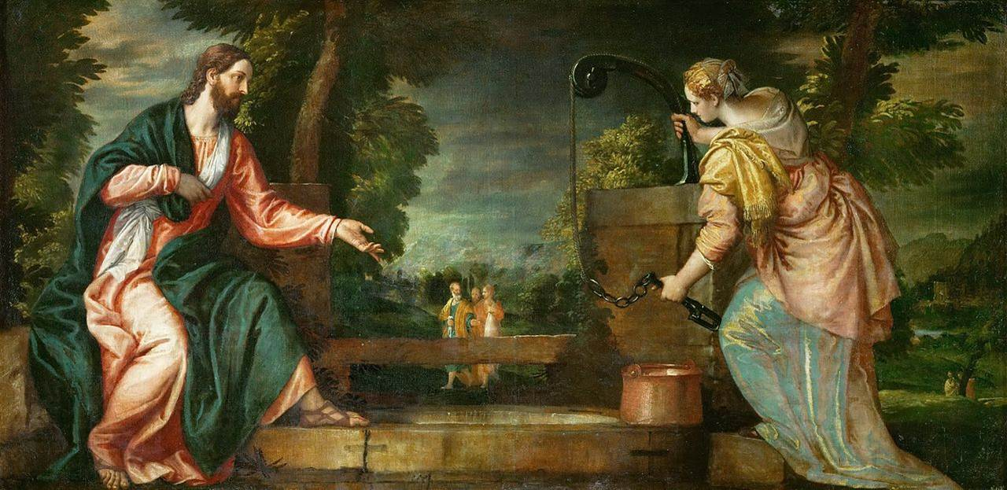
Christ and the Samaritan Woman at the Well(요 4:7)

Slide 26
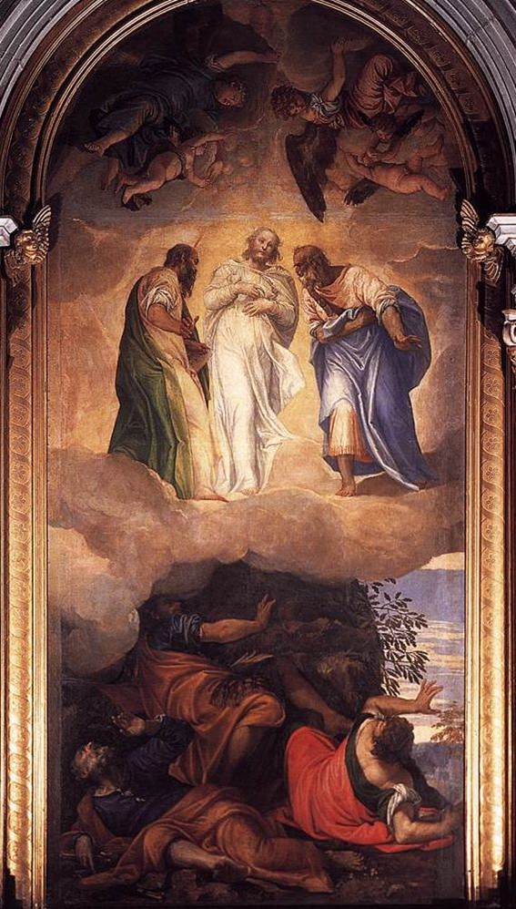
The Transfiguration(마 17:1)

Slide 27
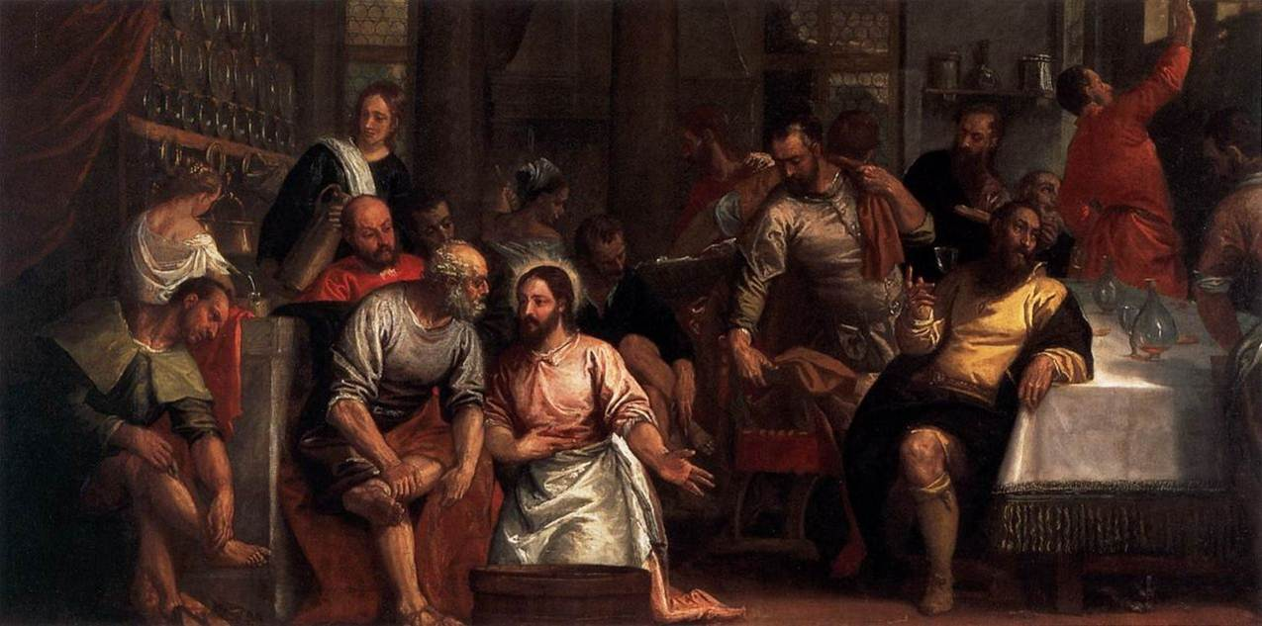
Christ Washing the Feet of the Disciples

Slide 28
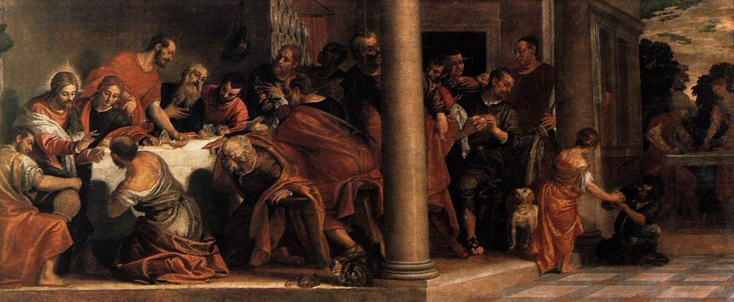
Last Supper(마 26:6)

Slide 29
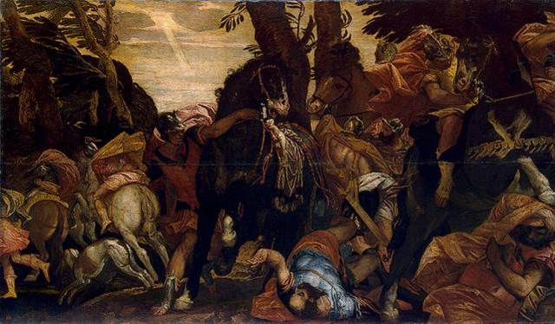
The Conversion of Saul(행 9:4)

Slide 30
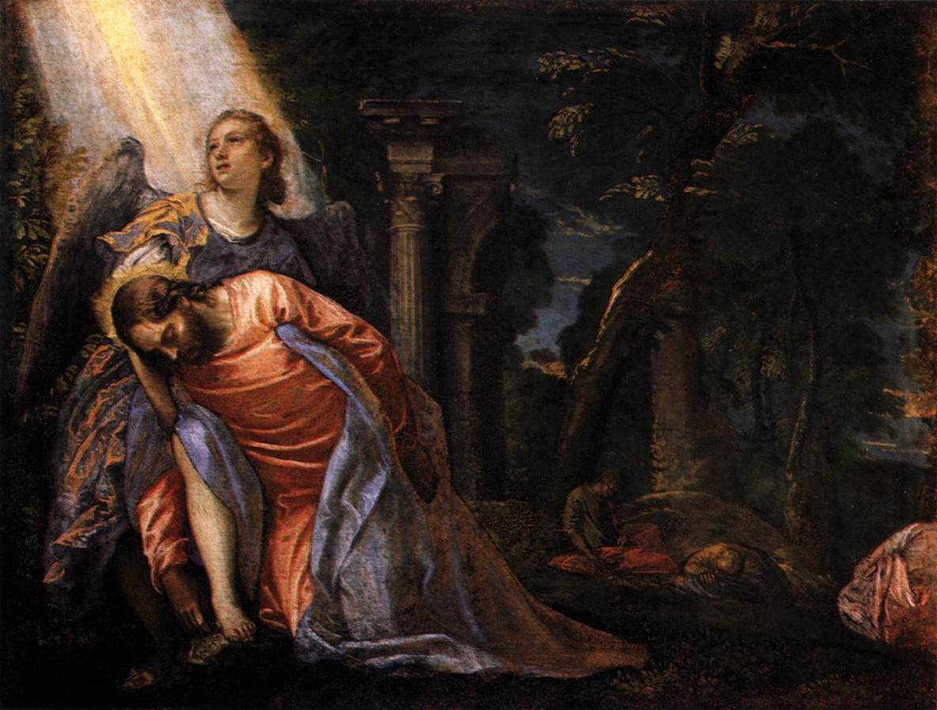
Christ in the Garden of Gethsemane(마 26:36)

Slide 31
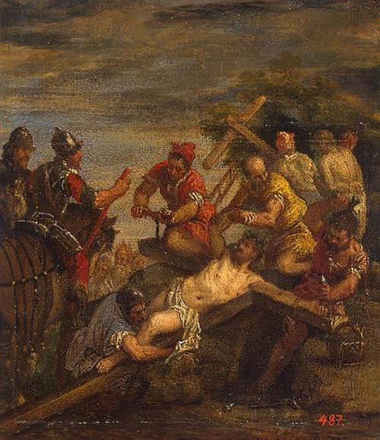
Nailing to the Cross

Slide 32
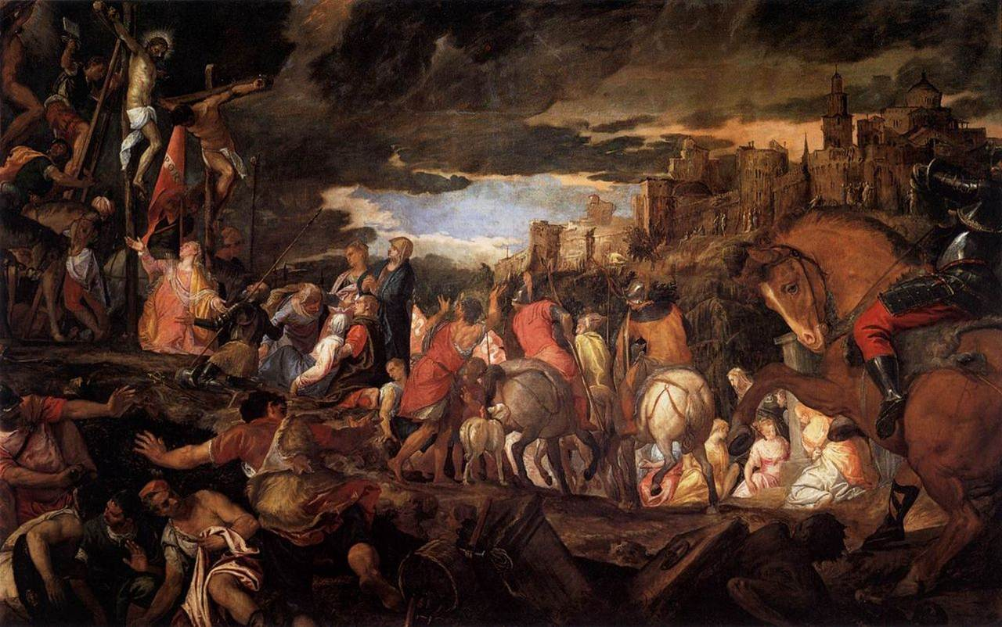
Crucifixion

Slide 33
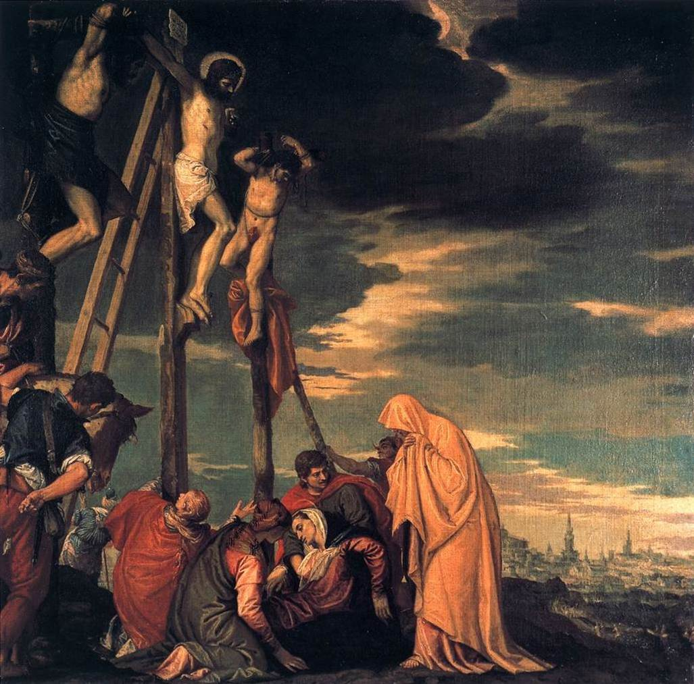
Crucifixion

Slide 34
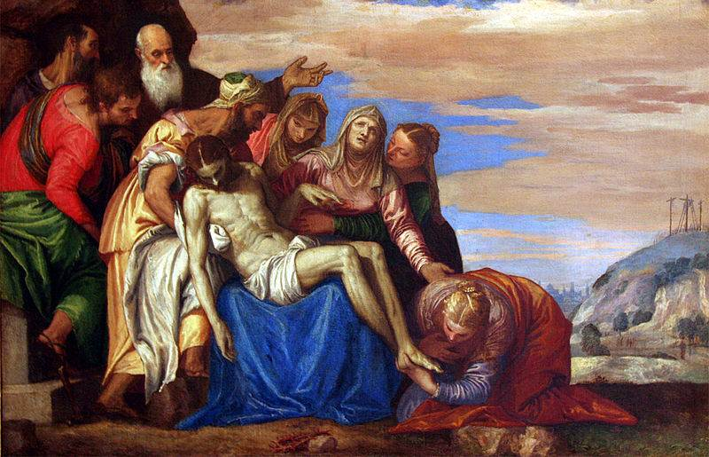
Deposition of Christ
Notes:
Deposition of Christ

Slide 35
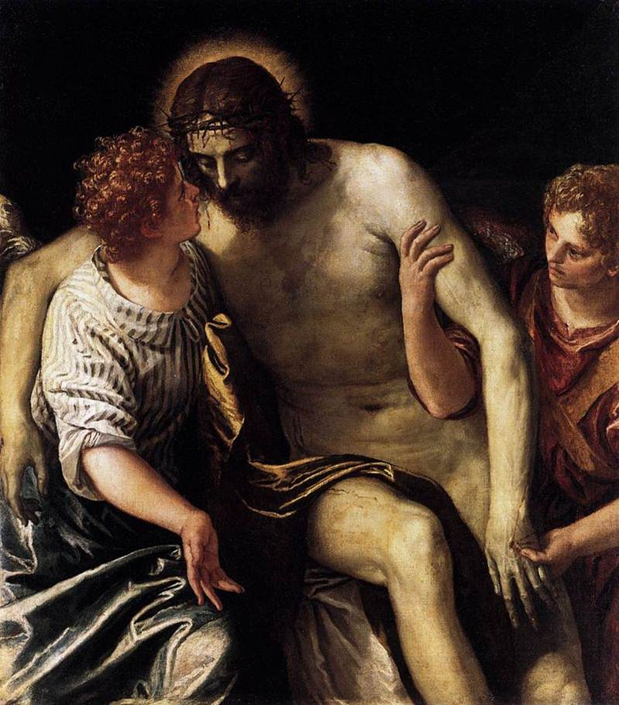
Dead Christ
Supported
by Two Angels

Slide 36
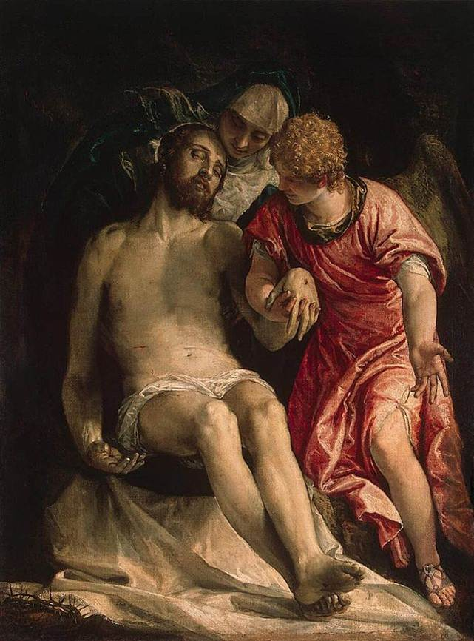
Pietà

Slide 37
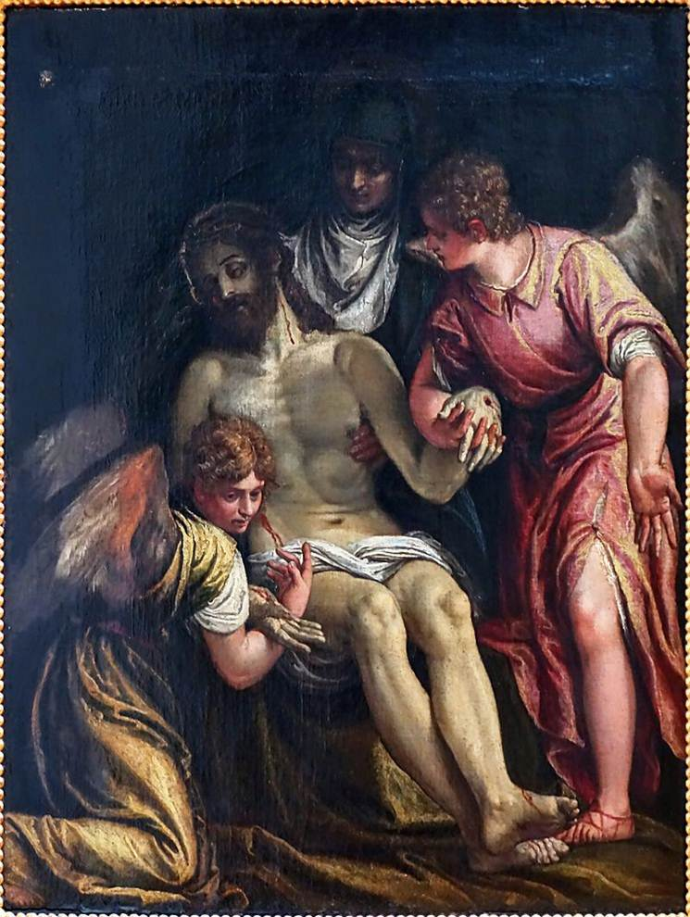
The lamentation over the dead Christ by Virgin and two angels

Slide 38
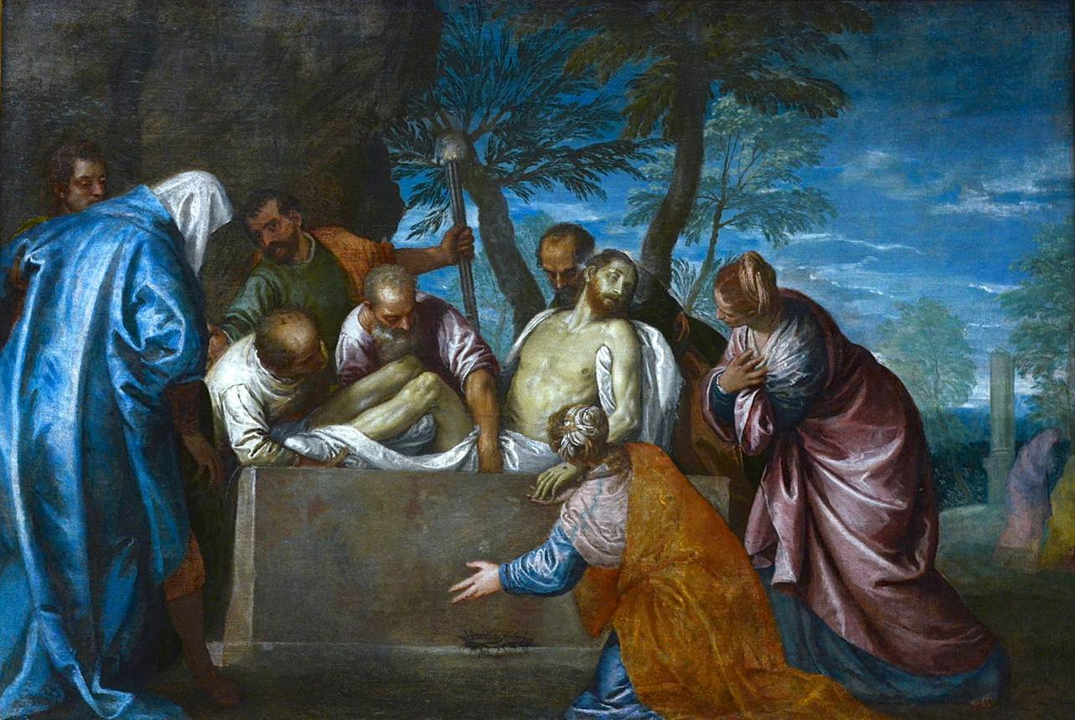
The Entombment

Slide 39
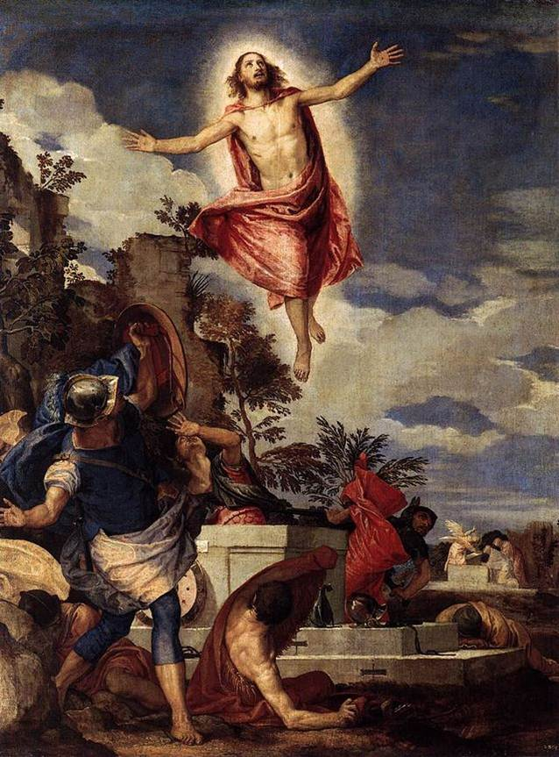
The Resurrection of Christ

Slide 40
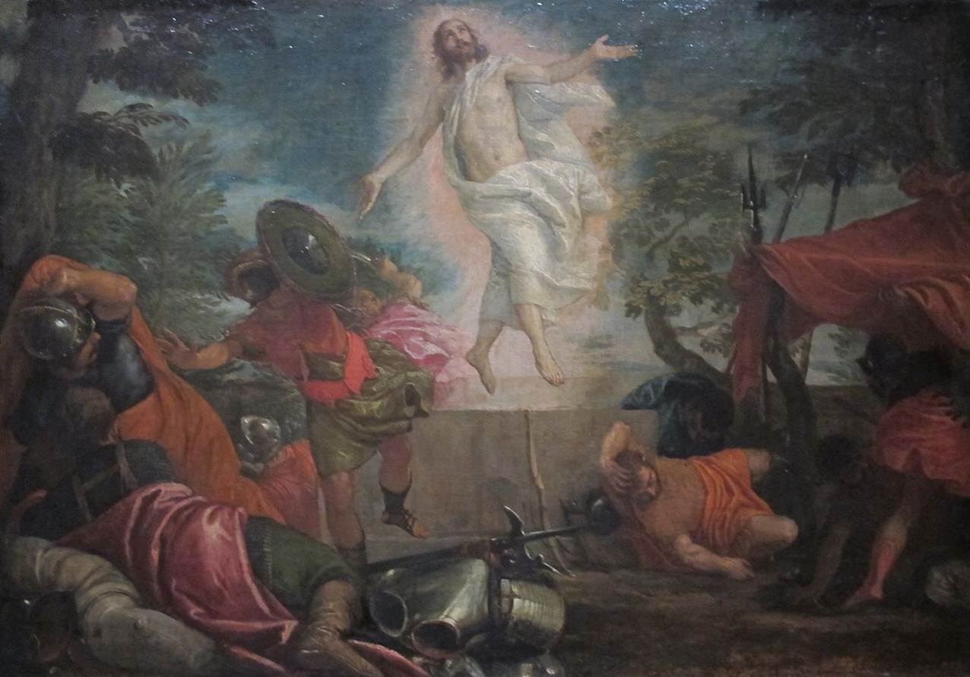
The Resurrection of Christ

Slide 41
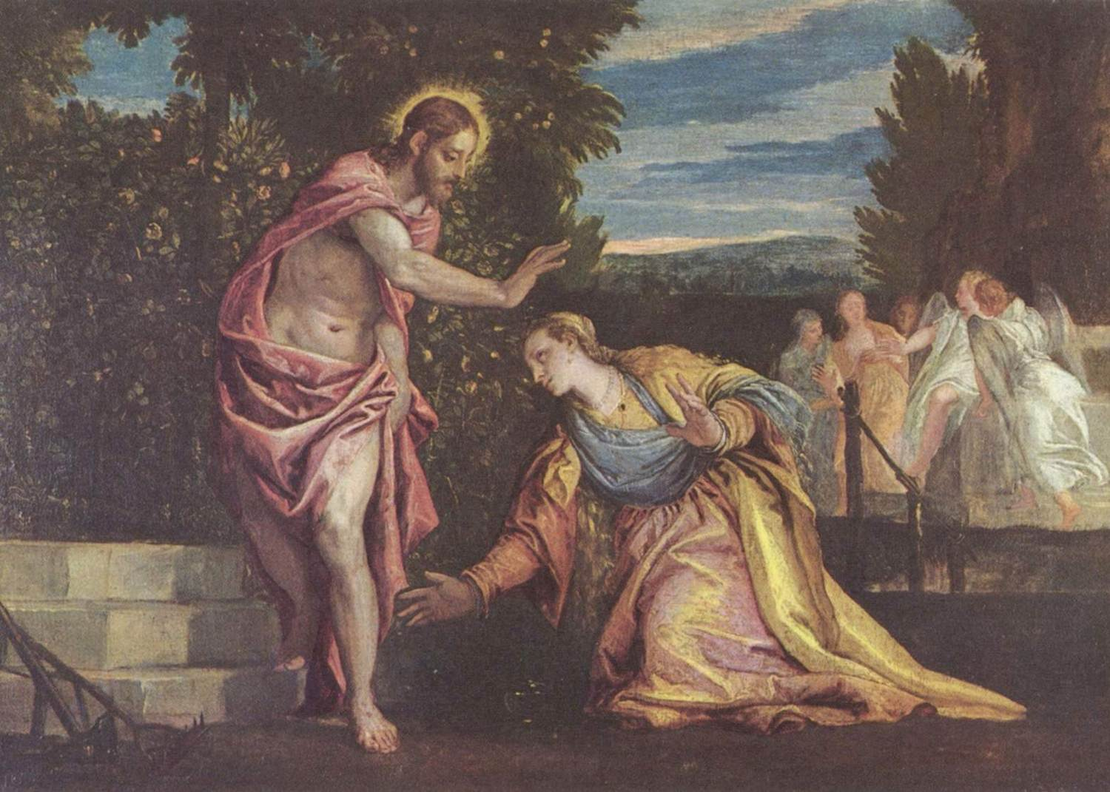
Noli Me Tangere(요 20:17)

Slide 42
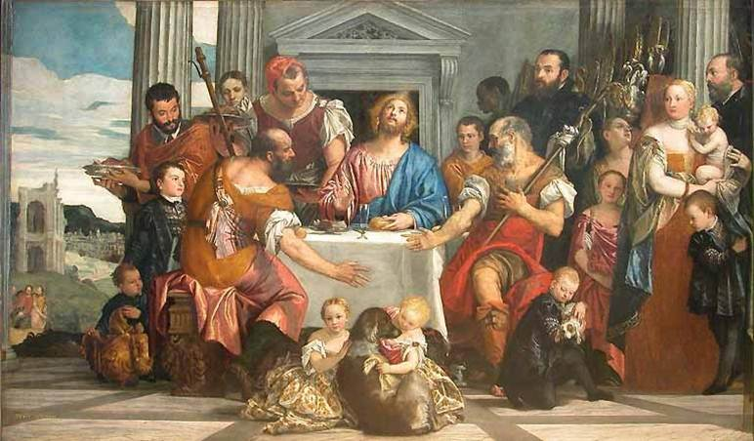
Supper in Emmaus(눅 24:31)

Slide 43
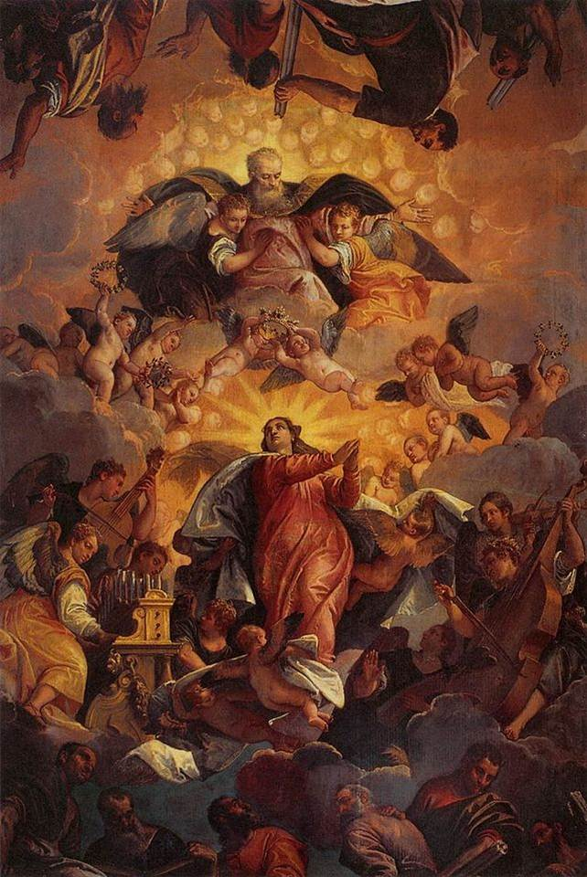
Assumption of Mary

Slide 44
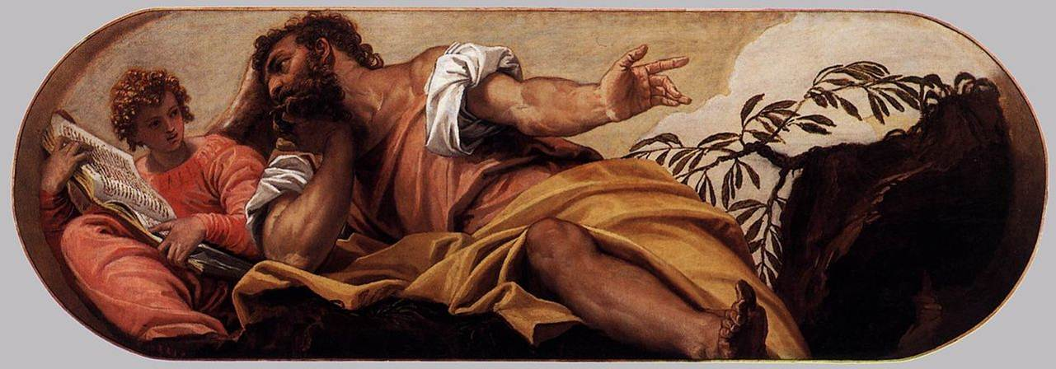
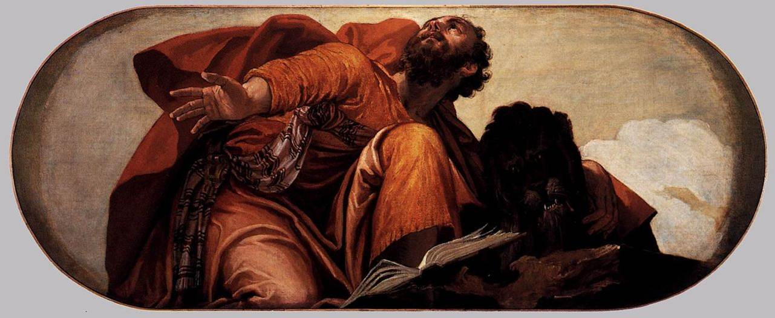
Saint Matthew the Evangelist
Saint Mark the Evangelist

Slide 45
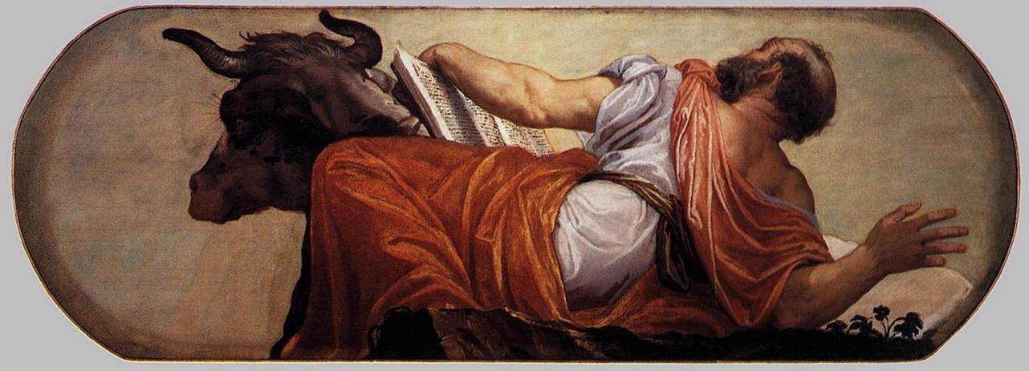
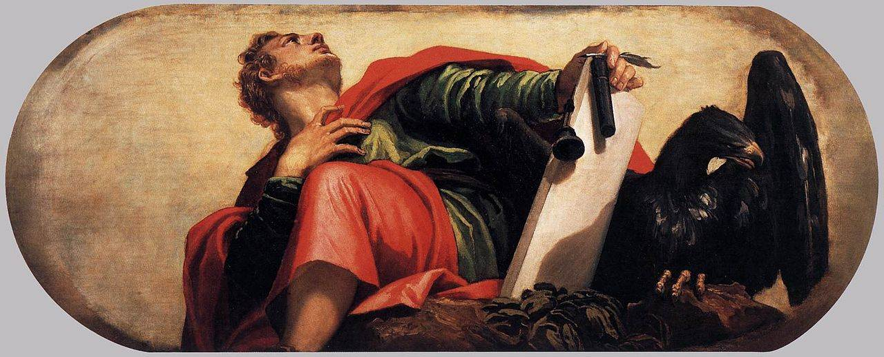
Saint Luke the Evangelist
Saint John the Evangelist
END

